Slide 1

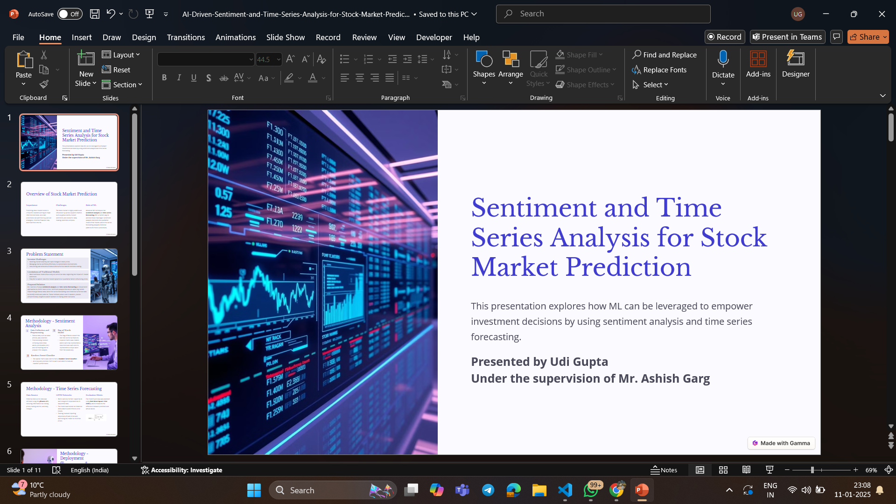
Sentiment and Time Series Analysis for Stock Market Prediction
This presentation explores how ML can be leveraged to empower investment decisions by using sentiment analysis and time series forecasting.
Presented by Udi Gupta
Under the supervision of Mr. Ashish Garg

Slide 2
Overview of Stock Market Prediction
Importance
Challenges
Role of ML
Predicting stock market trends is critical for investors aiming to make informed decisions. Accurate predictions can optimize buy and sell strategies, minimize financial risks, and maximize returns.
The stock market is highly volatile and influenced by various dynamic factors such as global events, market sentiment, and economic data, making prediction complex.
Advanced ML techniques like sentiment analysis and time series forecasting offer a holistic way to address these challenges. Sentiment analysis interprets the qualitative mood of the market, while time series forecasting analyzes historical patterns for future predictions.

Slide 3

Problem Statement
Investor Challenges
Handling market volatility and rapid changes in stock prices.
Managing diverse portfolios effectively in unpredictable environments.
Interpreting vast amounts of textual and numerical data for decision-making.
Limitations of Traditional Models
Most traditional models focus only on numerical data, neglecting the impact of market sentiment.
They fail to capture real-time market dynamics or qualitative factors influencing prices.
Proposed Solution
Our solution employs sentiment analysis and time series forecasting as independent approaches to predict stock prices. Sentiment analysis focuses on capturing market mood through textual data, while time series forecasting uses historical numerical data to identify trends and patterns. These methods, when used in tandem, provide complementary insights to assist investors in making better decisions.

Slide 4

Methodology - Sentiment Analysis
Data Collection and Preprocessing
2
Bag of Words Model
1
Textual data, such as news articles, was collected.
Preprocessing involved removing noise (stop words, punctuation, etc.) and normalizing text to prepare it for analysis.
The Bag of Words convert the text into numerical features.
A sparse matrix was created, where each row represented a document and each column represented a unique word from the vocabulary.
3
Random Forest Classifier
The sparse matrix was used to train a Random Forest Classifier.
Accuracy and precision metrics were calculated to evaluate classifier performance.

Slide 5
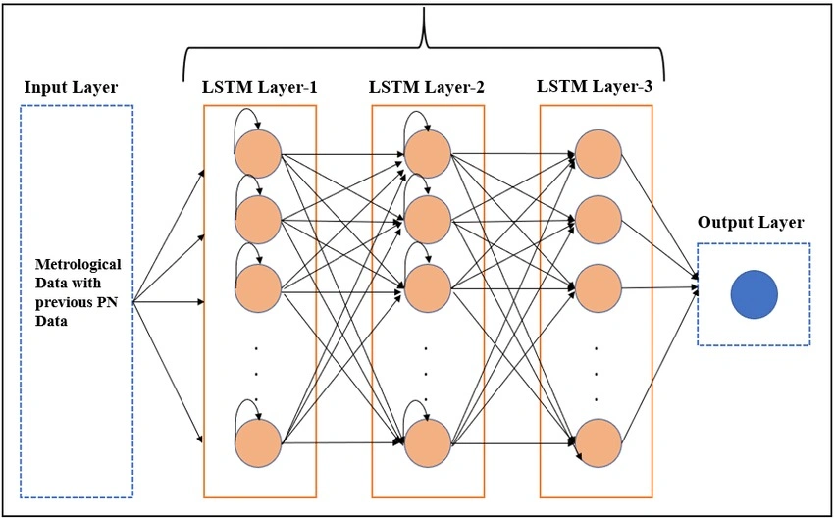
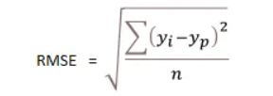
Methodology - Time Series Forecasting
Data Source
LSTM Networks
Evaluation Metric
Historical stock price data was retrieved using the yfinance API, including information like closing prices, trading volume, and daily changes.
Were used due to their capability to learn long-term dependencies in sequential data.
The model was trained on historical stock data to predict future price trends.
Training involved inputting sequences of past prices and optimizing the model to minimize errors.
The model’s accuracy was assessed using Root Mean Square Error (RMSE), which measures the difference between predicted and actual values.
LSTM Architecture

Slide 6

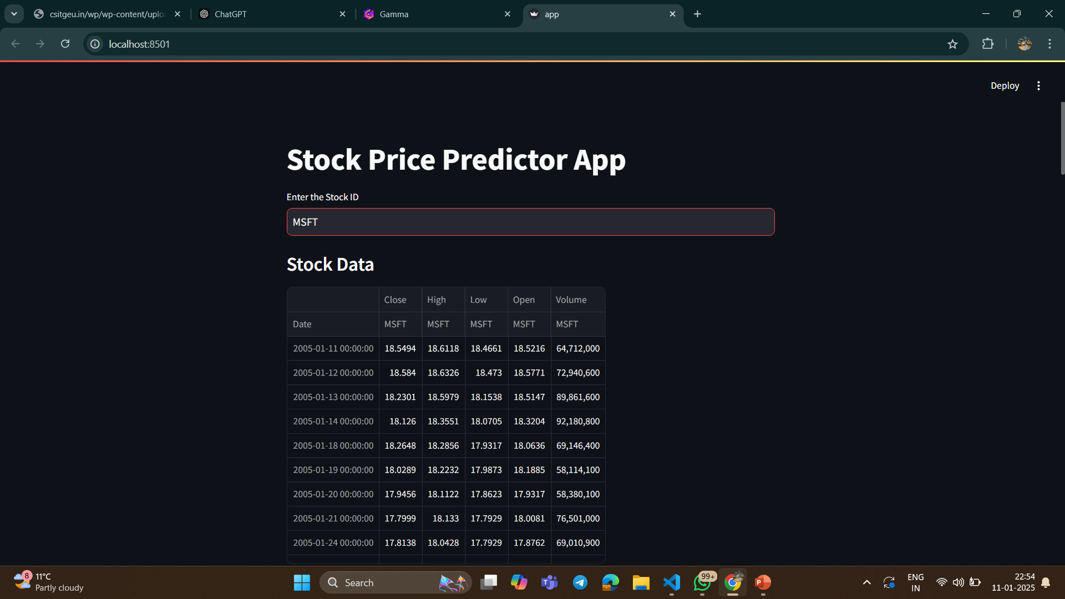



Methodology - Deployment
Model Saving
Streamlit Interface
The trained LSTM model was saved using appropriate serialization methods to enable seamless deployment in a .keras file.
A web application was built using Streamlit, providing users with an interactive interface to predict stock prices.
Users can input stock tickers, and the app retrieves live data from yfinance to generate predictions.
User Features
Graphs comparing predicted and actual stock prices.
Simple and intuitive interface designed for investors and analysts.

Slide 7

Results - Sentiment Analysis
Classifier Accuracy
Sentiment Trends
The Random Forest model achieved an accuracy of 87%, effectively categorizing sentiment.
Positive sentiment correlated with stock price increases.
Negative sentiment often aligned with price declines, providing actionable insights for investors.
Key Impact
Sentiment analysis enhanced the model’s ability to consider market mood alongside numerical data, improving overall prediction accuracy.

Slide 8

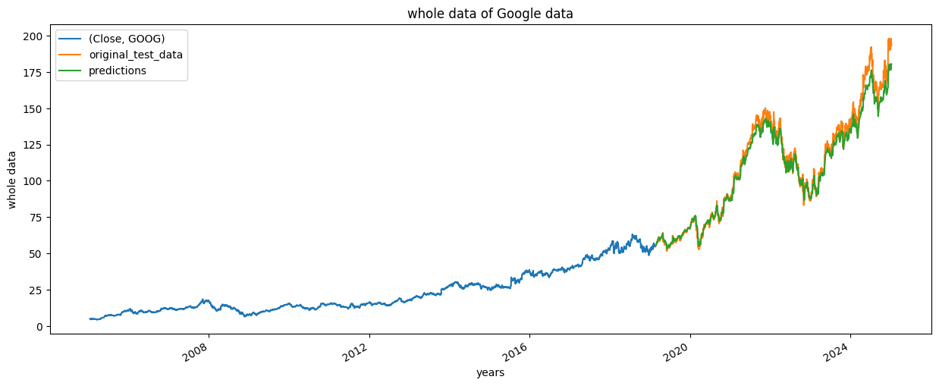
Results - Time Series Forecasting
LSTM Performance
Visualization
The LSTM model achieved an RMSE of 2.9205, indicating strong predictive performance.
Graphs depicting actual vs. predicted prices showcased the model’s effectiveness.

Slide 9



Discussion
Strengths
1
Robust performance in volatile market conditions.
User-friendly deployment enables practical usability.
Limitations
2
Dependence on high-quality and timely sentiment data.
Sensitivity to abrupt market events or anomalies.
Comparative Analysis
3
LSTM demonstrated superior performance compared to simpler models in both trend identification and accuracy.

Slide 10
Conclusion and Future Work
Conclusion
Deployment via Streamlit enhanced accessibility for users.
1
Future Enhancements
Real-time sentiment analysis for continuous updates.
Integration of advanced NLP models like BERT for better sentiment understanding.
Addition of macroeconomic indicators, global events, and financial reports for richer data input.
2
Next Steps
Integration of Sentiment and Time Series Analysis for more comprehensive predictions.
Optimization of models through hyperparameter tuning and hybrid techniques.
3

Slide 11
Thank You

